Slide 1
Understanding General Software Development
Lesson 3

Slide 2
Objective Domain Matrix
Skills/Concepts | MTA Exam Objectives
Understanding Application Lifecycle Management | Understand application lifecycle management (3.1)
Understanding Testing | Understand application lifecycle management (3.1)
Understanding Data Structures | Understand algorithms and data structures (3.3)
Understanding Sorting Algorithms | Understand algorithms and data structures (3.3)
Notes:
Tip: Add your own speaker notes here.

Slide 3
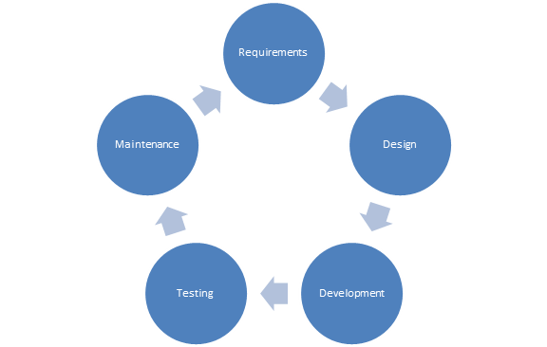
Application Lifecycle Management (ALM)
Application lifecycle management (ALM) is the set of activities that revolve around a new software product, from its inception to when the product matures.
Notes:
Tip: Add your own speaker notes here.

Slide 4
Requirements
Requirements analysis is the process of determining the detailed business requirements for a new software system.
A business analyst is responsible for analyzing business needs and converting them into requirements that can be executed by the development team.
Notes:
Tip: Add your own speaker notes here.

Slide 5
Design
The design activity is used to create plans, models, and architecture for how the software will be implemented.
Participants
Architect
User-experience Designer
Notes:
Tip: Add your own speaker notes here.

Slide 6
Development
The software development activity involves implementing design by creating software code, databases, and other related content.
Participants
Developers
Database Administrators (DBAs)
Technical Writers
Content Developers
Notes:
Tip: Add your own speaker notes here.

Slide 7
Testing
Testing is used to assure the quality of the final product.
Identifies possible gaps between the system expectations described in the requirements document and actual system behavior.
Participants
Testers
Notes:
Tip: Add your own speaker notes here.

Slide 8
Understanding Testing
Software testing is the process of verifying software against its requirements.
Software testing can only help find defects—it cannot guarantee the absence of defects.
It is much more cost-effective to find defects earlier (rather than later) in the product development cycle.
Notes:
Tip: Add your own speaker notes here.

Slide 9
Testing Methods
Black-box Testing
Focusing solely on inputs and outputs.
Any knowledge of internal system workings is not used for testing.
Is used to make sure a software application covers all its requirements.
White-box Testing
Testers use their knowledge of system internals when testing the system.
Is used to make sure that each method or function has proper test cases available.
Notes:
Tip: Add your own speaker notes here.

Slide 10
Testing Levels
Unit Testing
Verifies the functionality of a unit of code.
Integration Testing
Assesses the interface between software components.
System Testing
Overall testing of the software system.
Regression Testing
Makes sure that each new fix doesn’t break anything that was previously working.
Notes:
Tip: Add your own speaker notes here.

Slide 11
Understanding Data Structures
Data structures are techniques for organizing and storing data in computer memory.
Understanding a data structure involves
Understanding the storage pattern,
Understanding what methods are used to create, access, and manipulate the data structure.
Common data structures
Arrays
Queues
Stacks
Linked Lists
Notes:
Tip: Add your own speaker notes here.

Slide 12
Arrays
An array is a collection of items of the same type.
The items in an array are stored in contiguous memory locations.
Capacity of an array is predefined and fixed.
Any array item can be directly accessed by using an index.
C# array indexes are zero-based.
Notes:
Tip: Add your own speaker notes here.

Slide 13
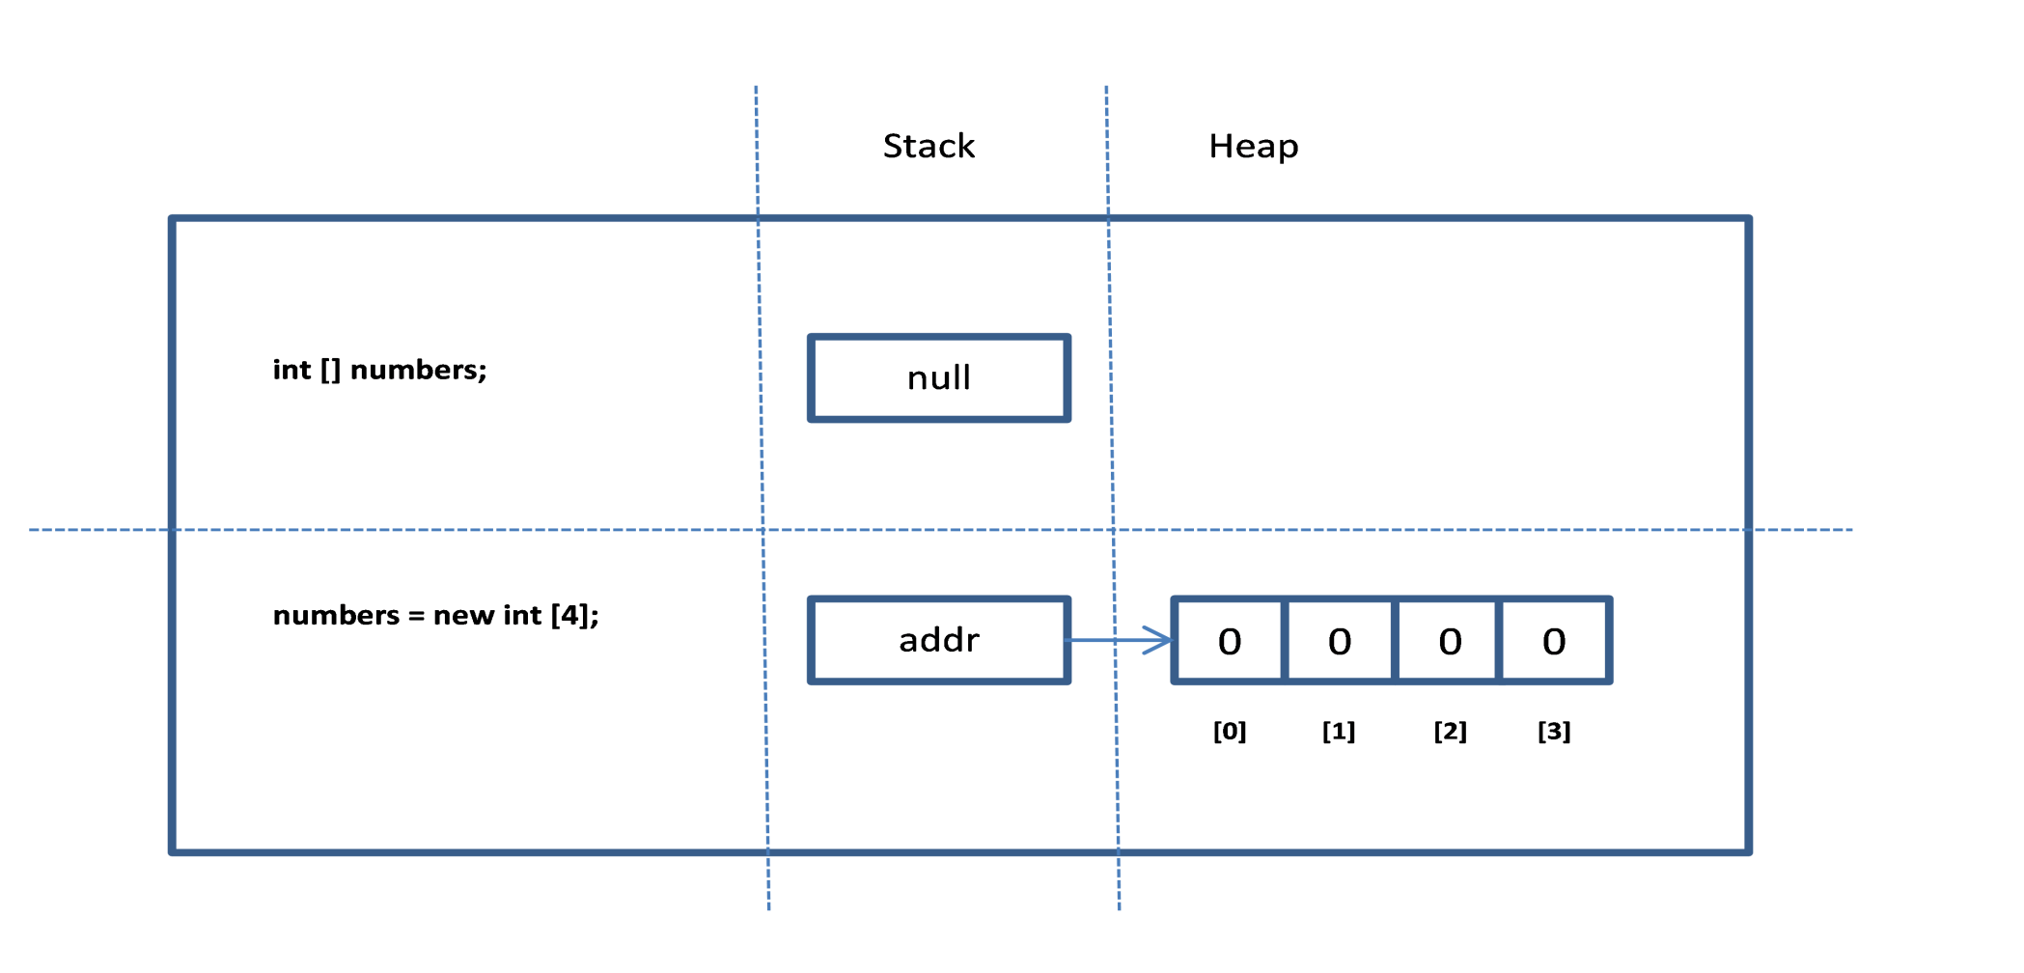
Array - Internal Representation
Notes:
Tip: Add your own speaker notes here.

Slide 14

Array – Common Operations
Arrays support the following operations:
Allocation
Access
Following code assigns a value of 10 to the fourth item of the array, and twice that value is then assigned to the variable calc:
Notes:
Tip: Add your own speaker notes here.

Slide 15
Queues
A collection of items in which the first item added to the collection is the first one to be removed.
First In First Out (FIFO).
Queue is a heterogeneous data structure.
Capacity of a queue is the number of items the queue can hold.
As elements are added to the queue, the capacity can be automatically increased.
Notes:
Tip: Add your own speaker notes here.

Slide 16
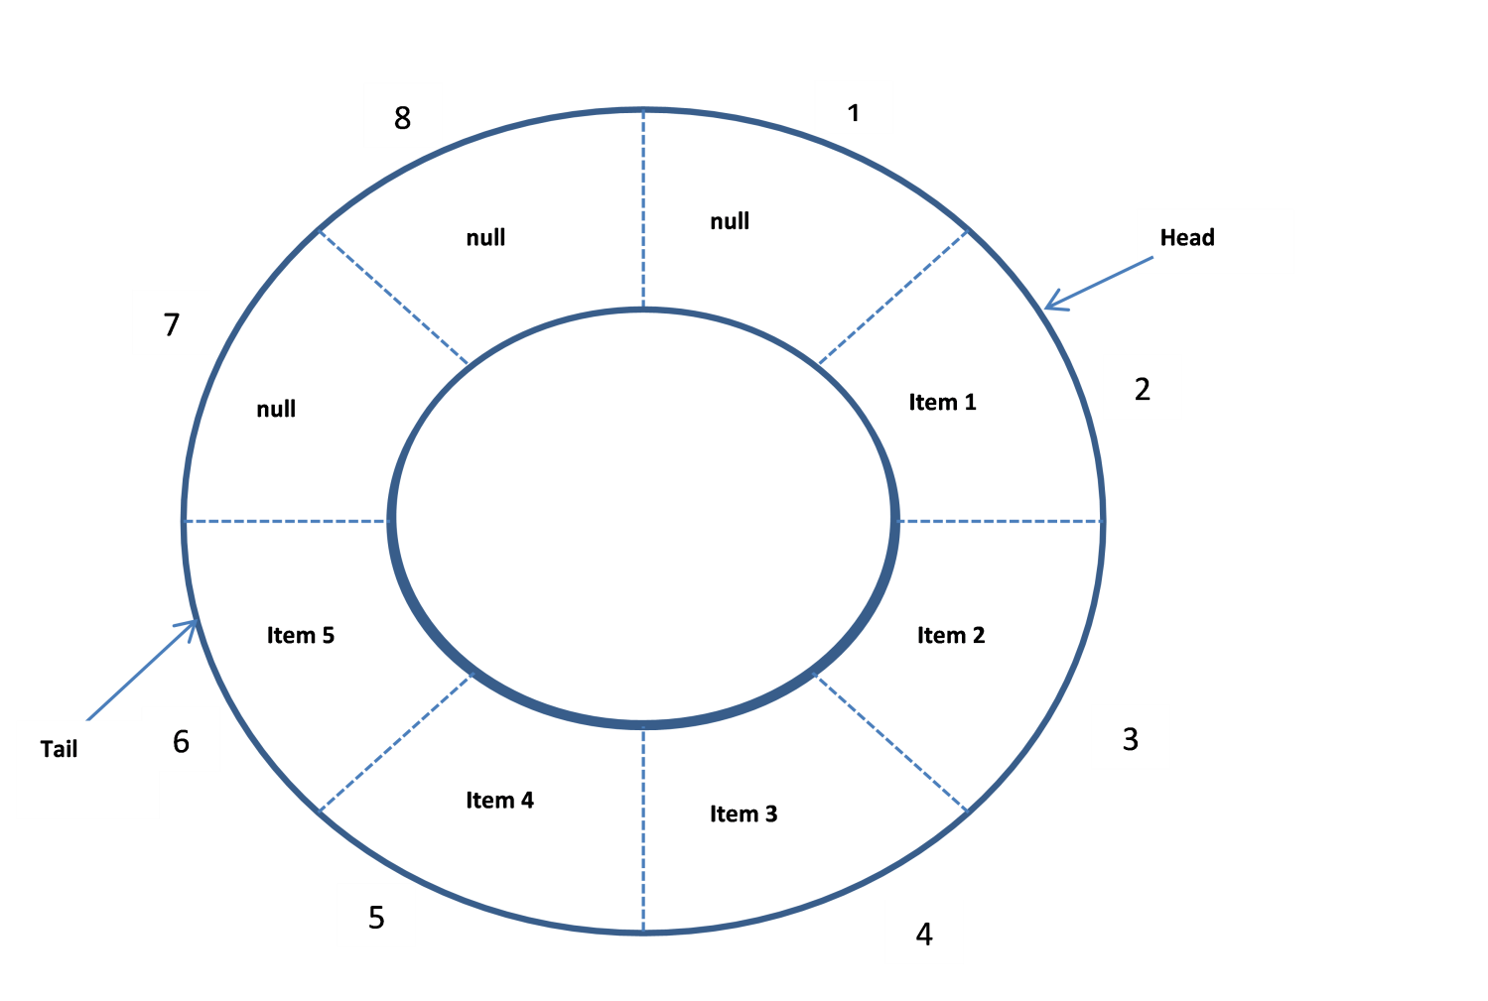
Queues – Internal Representation
Notes:
Tip: Add your own speaker notes here.

Slide 17
Queues – Common Operations
Enqueue: Adds an item to the tail end of the queue.
Dequeue: Removes the current element at the head of the queue.
Peek: Access the current item at the head position without actually removing it from the queue.
Contains: Determines whether a particular item exists in the queue.
Notes:
Tip: Add your own speaker notes here.

Slide 18
Stacks
A collection of items in which last item added to the collection is the first one to be removed.
Last In First Out (LIFO).
Stack is a heterogeneous data structure.
Capacity of a stack is the number of items the queue can hold.
As elements are added to the stack, the capacity can be automatically increased.
Notes:
Tip: Add your own speaker notes here.

Slide 19
Stacks – Internal Representation
A stack can be visualized just like the queue, except that the tail is called the top of the stack and the head is called the bottom of the stack.
New items are always added to the top of a stack; when this happens, the top of the stack starts pointing to the newly added element.
Items are also removed from the top of the stack, and when that happens, the top of the stack is adjusted to point to the next item in the stack.
Notes:
Tip: Add your own speaker notes here.

Slide 20
Stack – Common Operations
Push: Adds item to the top of the stack.
Pop: Removes the element at the top of the stack.
Peek: Access the current item at the top of the stack without actually removing it from the stack.
Contains: Determines whether a particular item exists in the stack.
Notes:
Tip: Add your own speaker notes here.

Slide 21
Linked Lists
A linked list is a collection of nodes arranged so that each node contains a link to the next node in the sequence.
Each node in a linked list contains of two pieces of information:
the data corresponding to the node
the link to the next node
Notes:
Tip: Add your own speaker notes here.

Slide 22
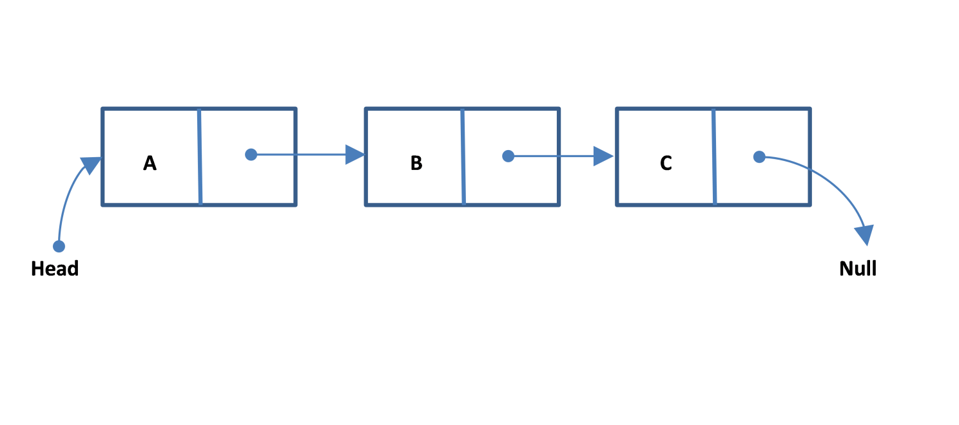
Linked Lists – Internal Representation
A singly linked list
Notes:
Tip: Add your own speaker notes here.

Slide 23
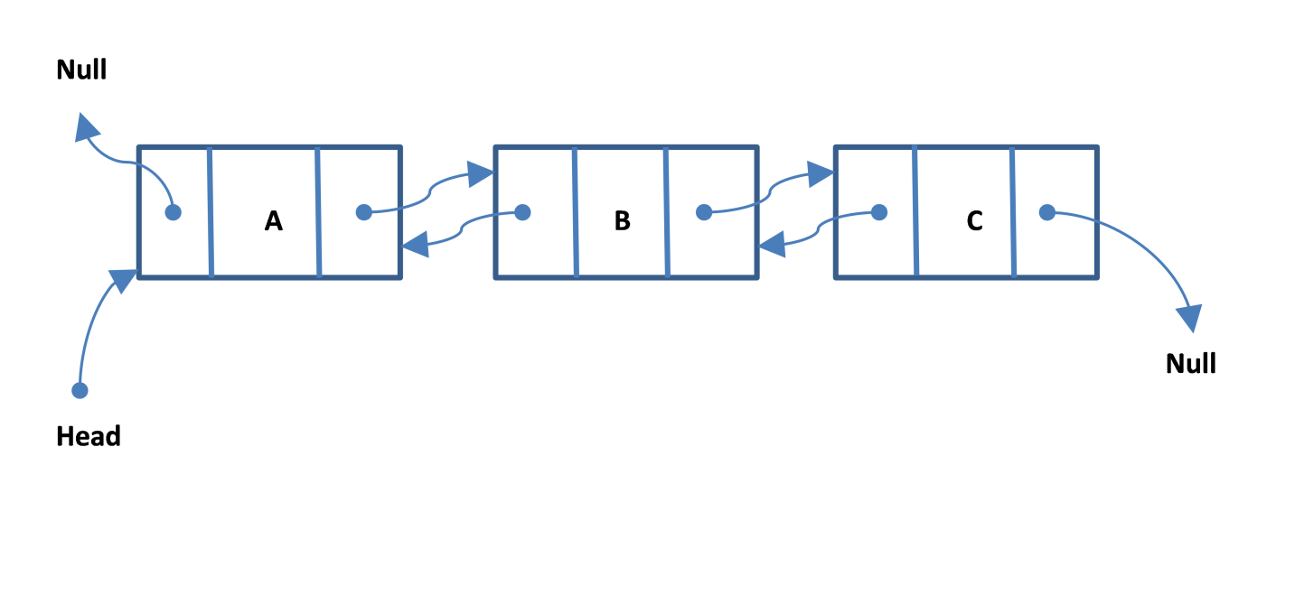
Linked Lists – Internal Representation
A doubly linked list
Notes:
Tip: Add your own speaker notes here.

Slide 24
Linked Lists – Common Operations
Add: Adds an item to a linked list.
Remove: Removes a given node from the linked list.
Find: Finds a node with a given value in the linked list.
Notes:
Tip: Add your own speaker notes here.

Slide 25
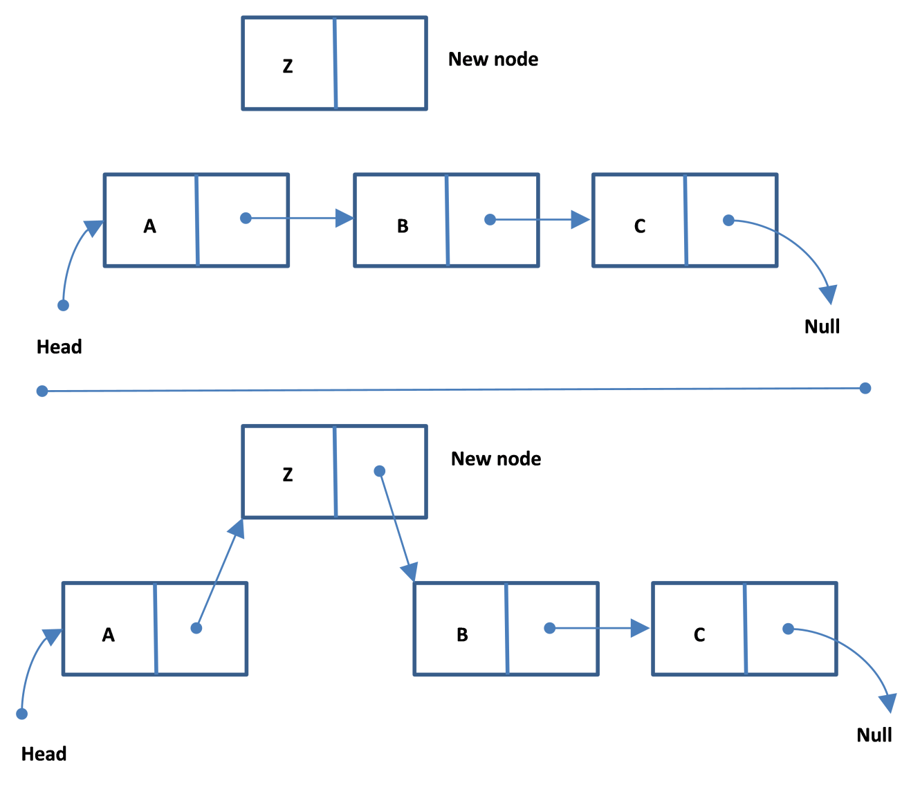
Linked Lists – Visualizing the add Operation
Adding an item to a linked list is a matter of changing links.
Notes:
Tip: Add your own speaker notes here.

Slide 26
Understanding Sorting Algorithms
Sorting algorithms are algorithms that arrange the items in a list in a certain order.
Understanding sorting algorithms can help you understand, analyze, and compare different methods of problem solving.
BubbleSort and QuickSort are two of many sorting algorithms .
Notes:
Tip: Add your own speaker notes here.

Slide 27
BubbleSort
BubbleSort works by comparing two elements to check whether they are out of order; if they are, it swaps them. The algorithm continues to do this until the entire list is in the desired order.
BubbleSort gets its name from the way the algorithm works: As the algorithm progresses, the smaller items are “bubbled” up.
Notes:
Tip: Add your own speaker notes here.

Slide 28
Visualizing BubbleSort – Pass 1
Notes:
Tip: Add your own speaker notes here.

Slide 29
Visualizing BubbleSort – Pass 2
Notes:
Tip: Add your own speaker notes here.

Slide 30
Visualizing BubbleSort – Pass 3
Notes:
Tip: Add your own speaker notes here.

Slide 31
QuickSort
The QuickSort algorithm uses the divide-and-conquer technique to continually partition a list until the size of the problem is small and doesn’t require any sorting.
QuickSort algorithm works much faster than BubbleSort.
Notes:
Tip: Add your own speaker notes here.

Slide 32
Visualizing QuickSort
Notes:
Tip: Add your own speaker notes here.

Slide 33
Recap
Application Lifecycle Management
Requirement Analysis
Software Development
Testing
Release Management
Testing Methods
Black-box Testing
White-box Testing

Slide 34
Recap
Testing Levels
Unit testing, integration testing, system testing, acceptance testing
Data Structures
Arrays
Queues
Stacks
Linked Lists
Sorting Algorithms: BubbleSort, QuickSort

